Slide 1

Student Result Analysis
A comprehensive examination of how demographic, social, and family-related factors influence academic achievement across Mathematics, Reading, and Writing for over 30,000 students

Slide 2




Project Goals and Scope
Pattern Identification
Data Quality
Analyze how demographic and family factors correlate with academic performance across three core subjects
Perform thorough data cleaning, handle missing values, and remove unnecessary fields to ensure analytical integrity
Insight Generation
Create meaningful visualizations to uncover actionable insights that can guide educational improvement strategies

Slide 3
Dataset Overview
Scale and Structure
Missing Data Profile
The dataset encompasses 30,641 student records with 14 distinct variables covering demographics, family background, and academic performance.
While demographic fields contain gaps, all academic scores remain intact:
TransportMeans: 3,134 missing (10.2%)
Key categories include gender, ethnic group, parental education level, lunch type, test preparation status, parental marital status, sports practice frequency, birth order, number of siblings, transportation method, weekly study hours, and scores in three subjects.
EthnicGroup: 1,840 missing (6.0%)
ParentEduc: 1,845 missing (6.0%)
TestPrep: 1,830 missing (6.0%)
NrSiblings: 1,572 missing (5.1%)
Target Variables
Score integrity ensures reliable academic pattern analysis without requiring imputation.
MathScore, ReadingScore, WritingScore
All score fields complete with zero missing values

Slide 4

Academic Performance
66.6
69.4
68.4
Math Score
Reading Score
Writing Score
Average across all students
Highest performing subject
Mid-range performance
Score distributions span the full 0–100 range with no data entry anomalies detected. The 25th to 75th percentile ranges cluster tightly around the mean, indicating consistent performance across the student population with Mathematics showing the widest variation.

Slide 5
Data Preparation and Quality
01
02
Column Removal
Duplicate Check
Eliminated the redundant Unnamed: 0 index column that served no analytical purpose
Verified zero duplicate rows, confirming high data integrity and consistency throughout the dataset
03
04
Missing Value Assessment
Visualization Readiness
Reviewed gaps in demographic fields while confirming complete score data for accurate academic analysis
Structured all key fields for clean, reliable exploration and meaningful pattern detection

Slide 6
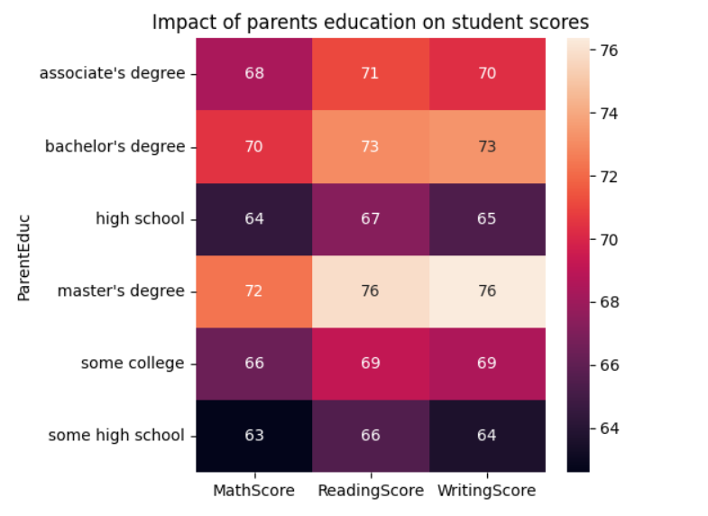
Key Finding: Parental Education Impact
Students with parents holding Master's degrees consistently achieve the highest scores across Math, Reading, and Writing, while those whose parents completed only some high school score lowest—demonstrating a strong correlation between parental education and student success.
This pattern reveals that parental educational background significantly shapes the academic support, resources, and learning environment available to children, influencing their readiness and motivation to excel.

Slide 7
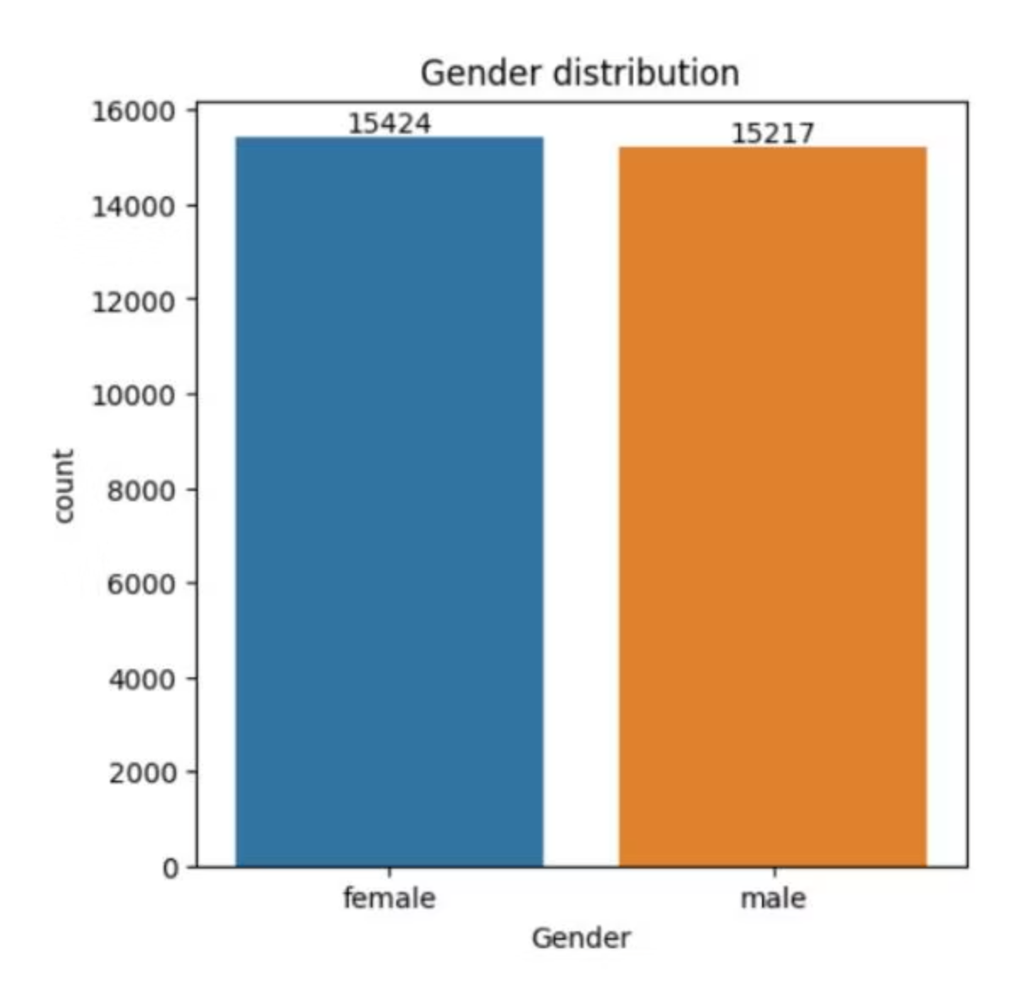
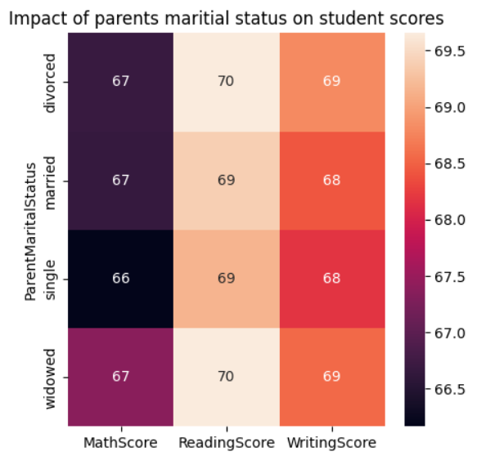
Gender and Marital Status Insights
Gender Distribution
Marital Status Effect
The dataset shows a nearly balanced gender split with females slightly outnumbering males. This minimal difference ensures gender-based insights remain naturally unbiased and representative of the full student population.
Analysis reveals minimal score variation between students of married, divorced, single, or widowed parents. This suggests that family structure alone does not drive academic outcomes—educational environment and parental involvement matter far more.

Slide 8
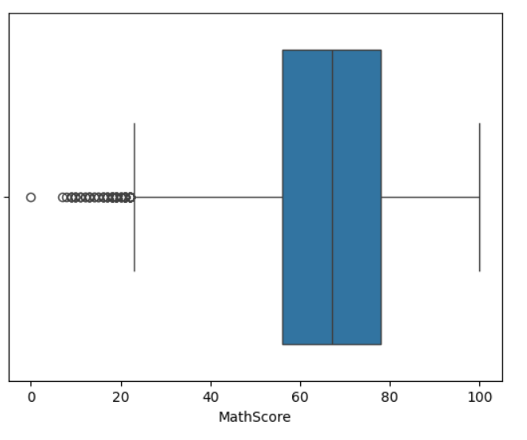
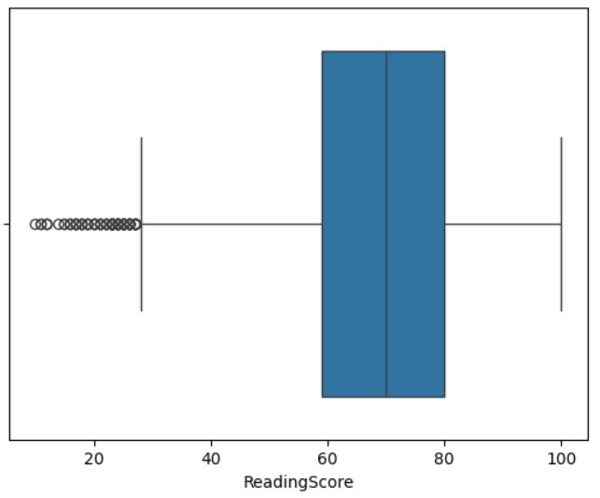
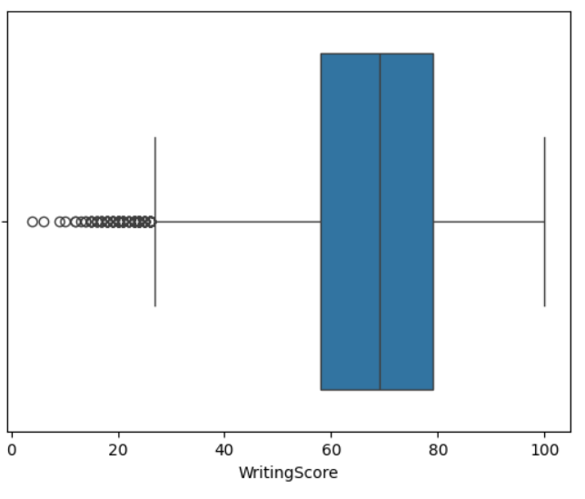
Subject Performance and Outlier Analysis
Clean Data Distribution
Math Challenges
Boxplots confirm no abnormal outliers—all scores fall within the valid 0–100 range, reinforcing dataset reliability
Mathematics shows a higher frequency of low scores compared to Reading and Writing, indicating students struggle most with quantitative reasoning
The consistency across Reading and Writing suggests strong verbal skills, while the Math performance gap highlights a clear opportunity for targeted intervention and support strategies.

Slide 9
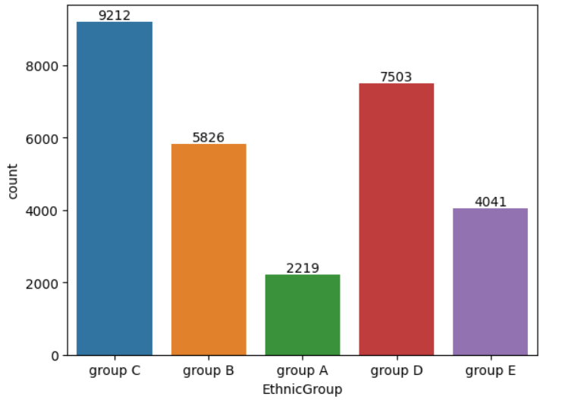
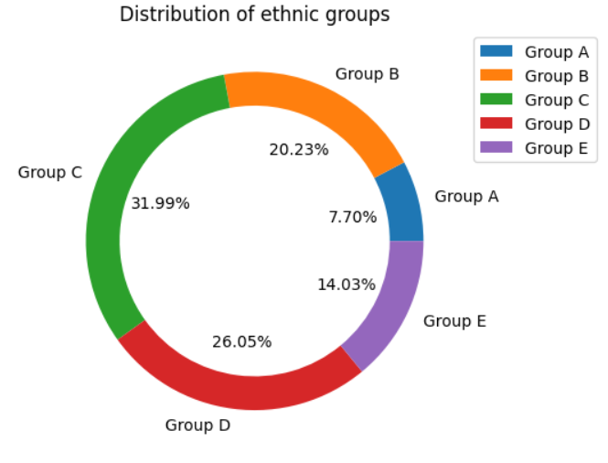
Ethnic Representation and Diversity
Group Distribution
Ethnic Group C represents the largest demographic (9212 – 31.99%), accounting for nearly one-third of all students in the dataset.
Other groups show varying but reasonable representation, enabling meaningful comparative analysis of academic patterns across ethnic categories.
The diverse representation allows for nuanced exploration of how cultural and community factors may intersect with academic achievement, though care must be taken to avoid overgeneralization.

Slide 10
Strategic Recommendations for Educators
1
2
Strengthen Math Support
Empower Parents
Implement remedial classes, concept-based teaching methods, and engaging digital tools to build problem-solving confidence
Provide workshops, simple study guides, and regular communication channels to support families with lower education levels
3
4
Enhance Test Preparation
Create Supportive Spaces
Use mock exams, structured revision periods, and guided practice to improve exam readiness and reduce anxiety
Establish quiet study zones, supervised homework areas, and resource rooms for personalized learning support
5
6
Track Progress Continuously
Foster Literacy and Mentorship
Deploy ongoing assessments to identify weak areas early and tailor interventions to individual student needs
Launch reading clubs, writing workshops, teacher mentorship programs, and small-group learning sessions for focused guidance

Slide 11
Conclusion
Our analysis reveals critical factors influencing student performance, guiding us toward targeted interventions for equitable educational outcomes.
Parental Education Link
Math Performance Gap
Parental educational background is a significant predictor of student academic achievement across all subjects.
Mathematics poses the greatest challenge, indicating a need for specialized support and engaging teaching methods.
Data-Driven Strategy
Fostering Growth
Insights from demographics and subject-specific trends enable precise and effective educational interventions.
Proactive support, inclusive environments, and continuous progress tracking are vital for student success.

